Slide 1
Islamic University of Gaza - Faculty of Information Technology
Special Topics 2 - Phase I: Project Analysis & Platform Sketching
Project Title: Blockchain-Based Certificate Verification Platform
Student: Adam Eyad Saleh - 120204353

Slide 2
Project Overview
A web platform to issue and verify academic certificates using blockchain.
Core: local blockchain or smart contract, optional Web3 integration.
Public verification via certificate hash or QR; issuer and admin dashboards.

Slide 3
Objectives & Roles
Objectives: prevent fraud, enable instant verification, keep audit trail.
Roles: Issuer (universities), Verifier (employers), Admin, Public.

Slide 4
Functional Requirements
Register/Login, Issue certificate (generate SHA-256), Verify, Revoke.
Admin panel: manage users/orgs, pricing and analytics.
Public/Verifier: verify by hash or upload PDF to compute hash.

Slide 5
Non-Functional Requirements
Security (HTTPS, roles, audit logs); Privacy (hash only).
Usability (clear UI, bilingual-ready); Scalability (modular).

Slide 6
Sitemap & User Flow
Auth -> Dashboards (Issuer / Verifier / Admin).
Issuer: New Certificate -> Generate Hash -> Publish (Local chain / Smart contract).
Verifier/Public: Enter Hash or Upload PDF -> Verify -> Result (Valid/Revoked/Not Found).

Slide 7
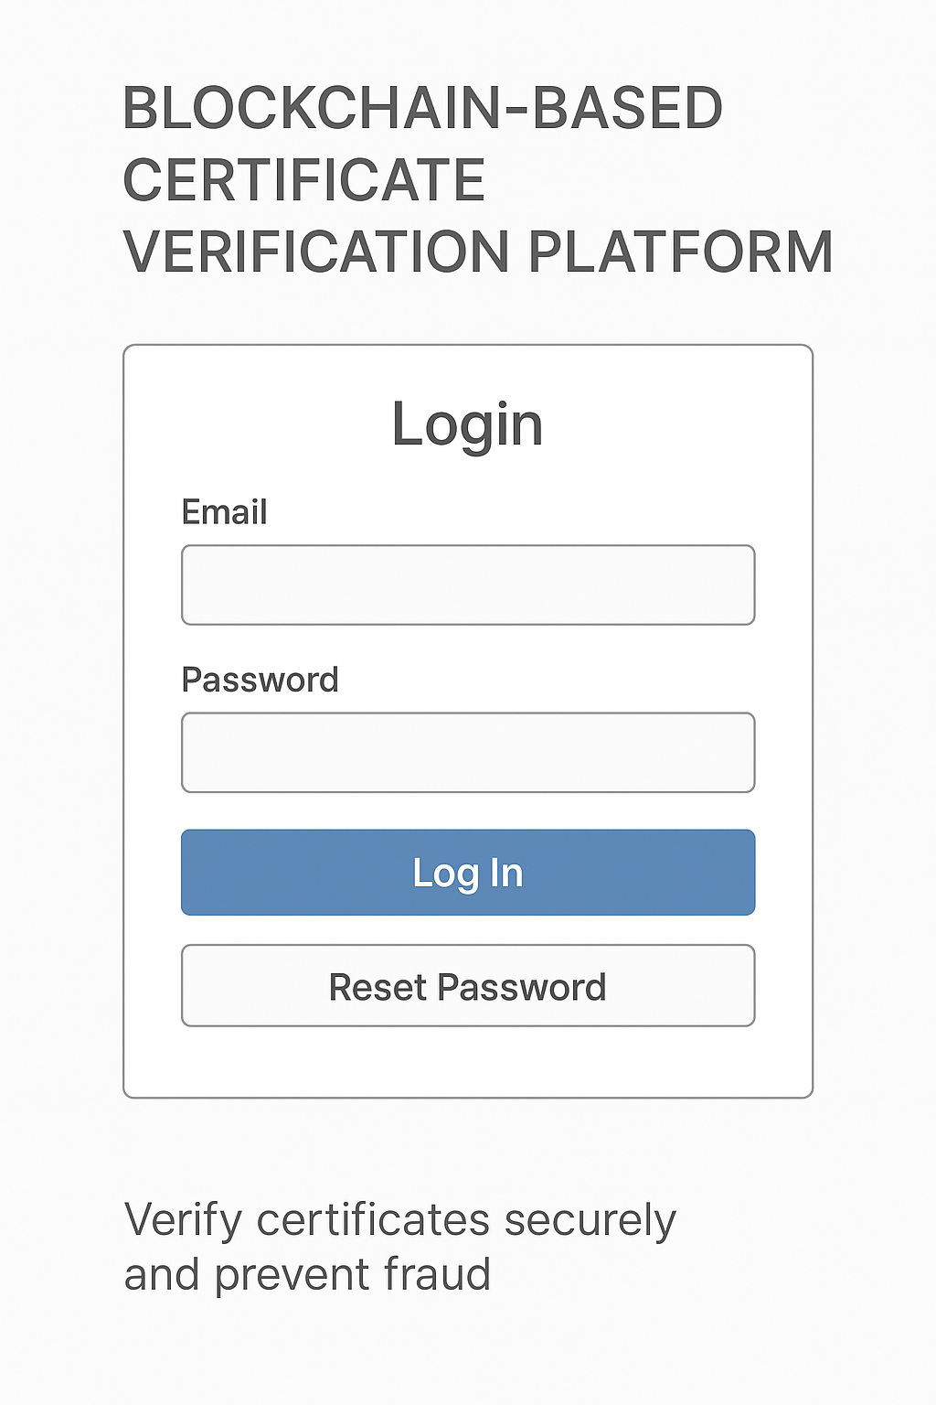
Wireframe - Login

Slide 8
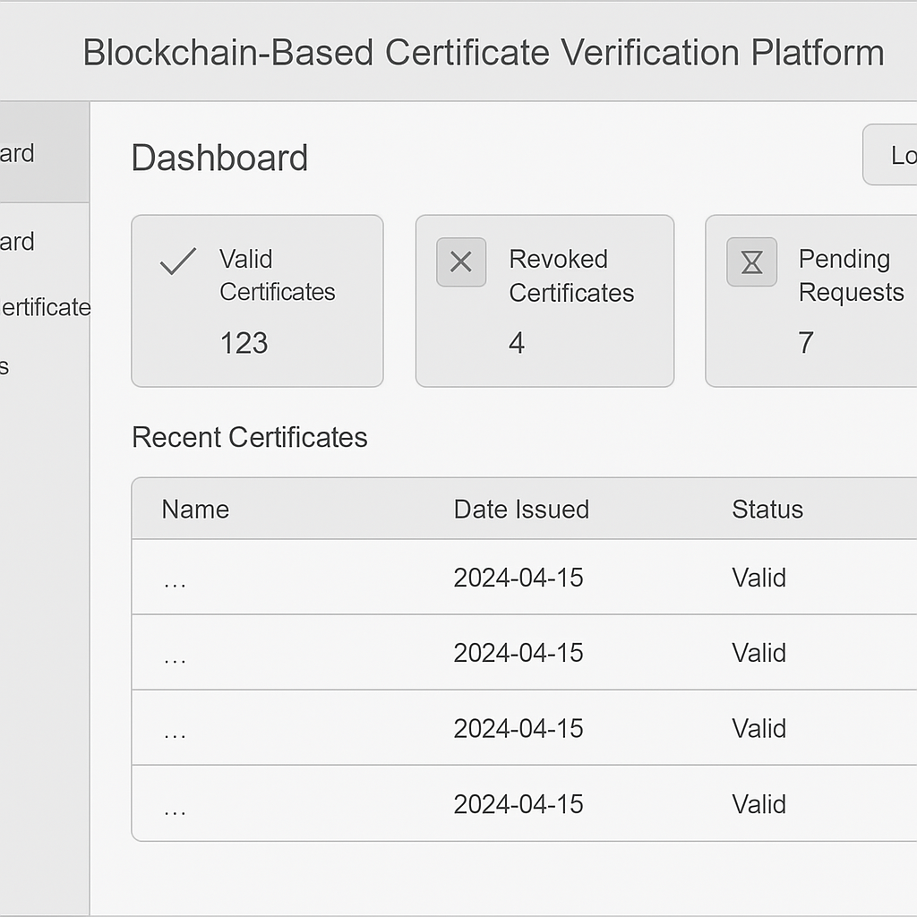
Wireframe - Issuer Dashboard

Slide 9
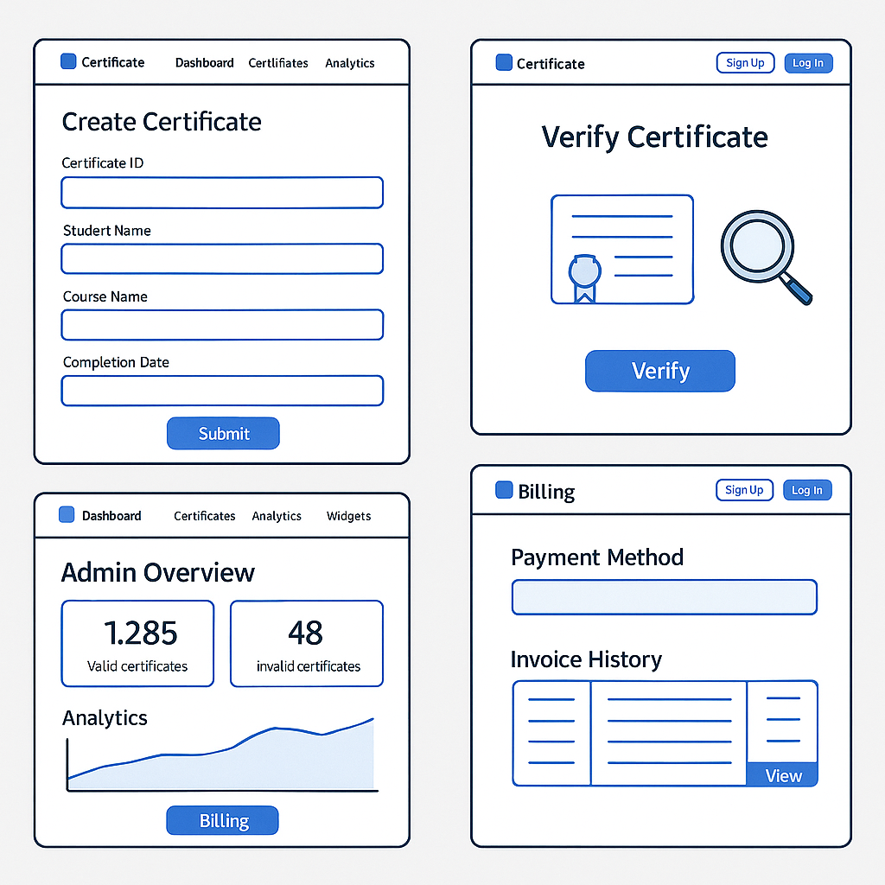
Wireframes - Create / Verify / Admin / Billing

Slide 10
Color & Summary
UI: blue gradient + white; flat academic style; Inter/Arial fonts.
Icons: Valid (green), Revoked (red), Pending (gray).
End of Phase I - Ready for implementation.

